Slide 1
Population structure
PCA
UMAP
ADMIXTURE
ConStruct

Slide 2
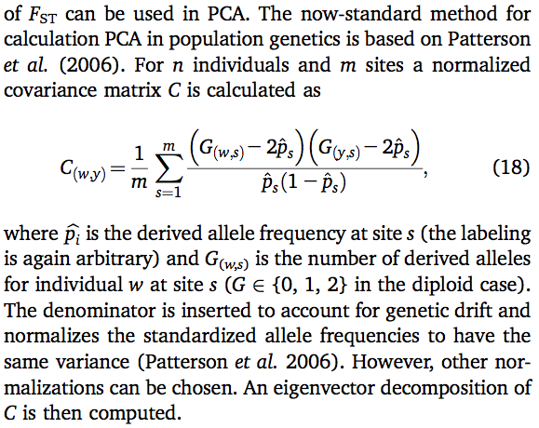
SNP covariance matrix

Slide 3
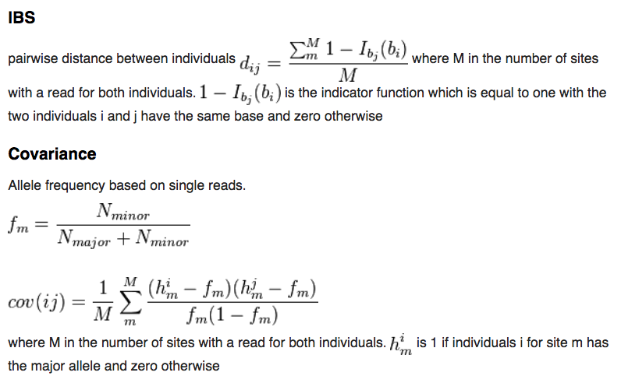
ANGSD: similarity matrices based on sampling a single read per SNP
(robust to variation in coverage among samples!)

Slide 4
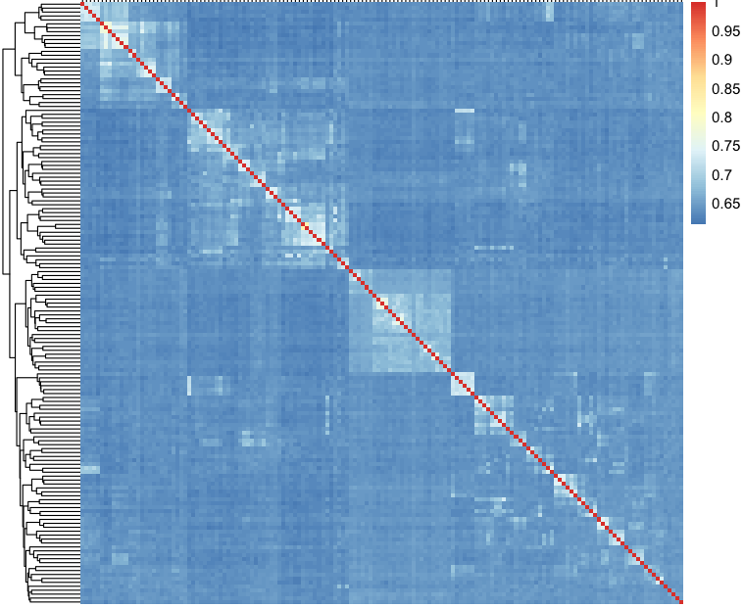
IBS matrix for 153 singing mice

Slide 5
Principal Component Analysis (PCA)
Input: data with multiple (potentially correlated) measurements
Desired output:
geometrically the same distribution of the data points, represented
in uncorrelated (orthogonal) coordinate axes and rotated to display the most important axes first
Unlike heatmaps / hierarchical clusters in the earlier slide, allows for statistical tests to verify significance of the observed groupings.

Slide 6
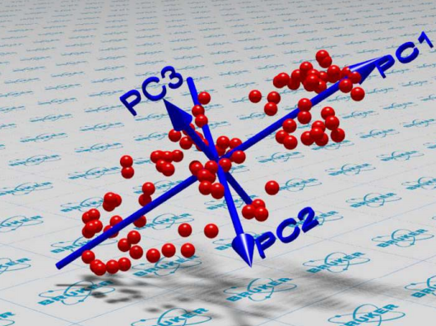
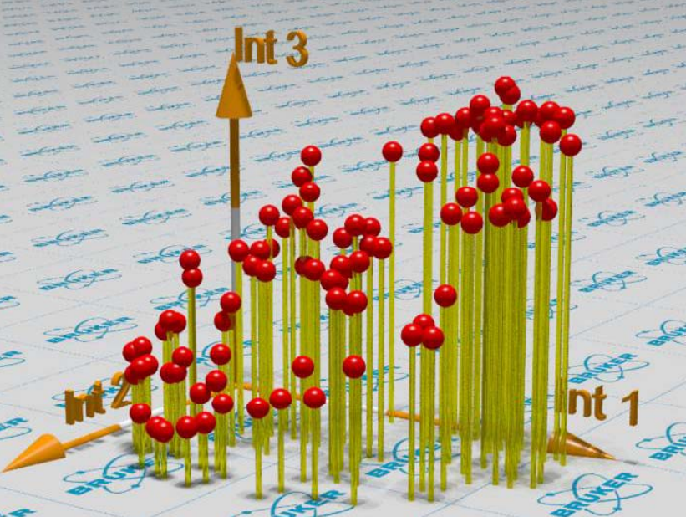
Principal Component Analysis

Slide 7
Principal Component Analysis

Slide 8
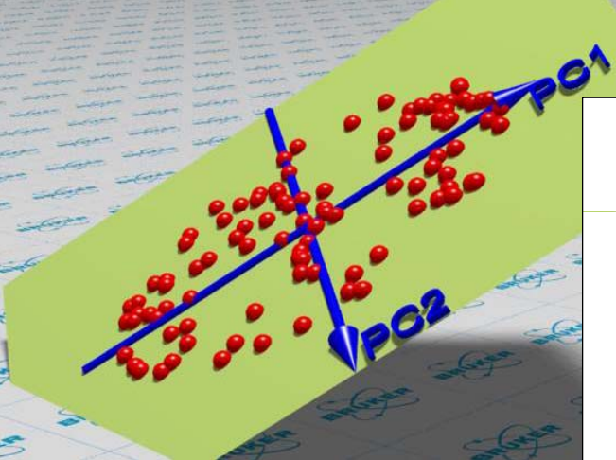
Principal Component Analysis

Slide 9
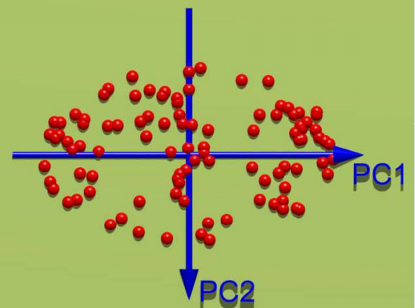
Principal Component Analysis

Slide 10
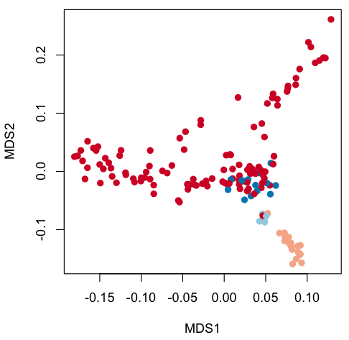
PCoA: takes not the original point coordinates, but square matrix of distances between points
vegan::capscale
vegan::adonis (to test for significance of grouping by specific factor)

Slide 11
Observed (whole genome):

Slide 12
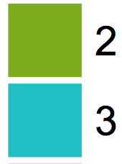
Observed (whole genome):
2
**
3

Slide 13
Observed (whole genome):
2
**
3

Slide 14
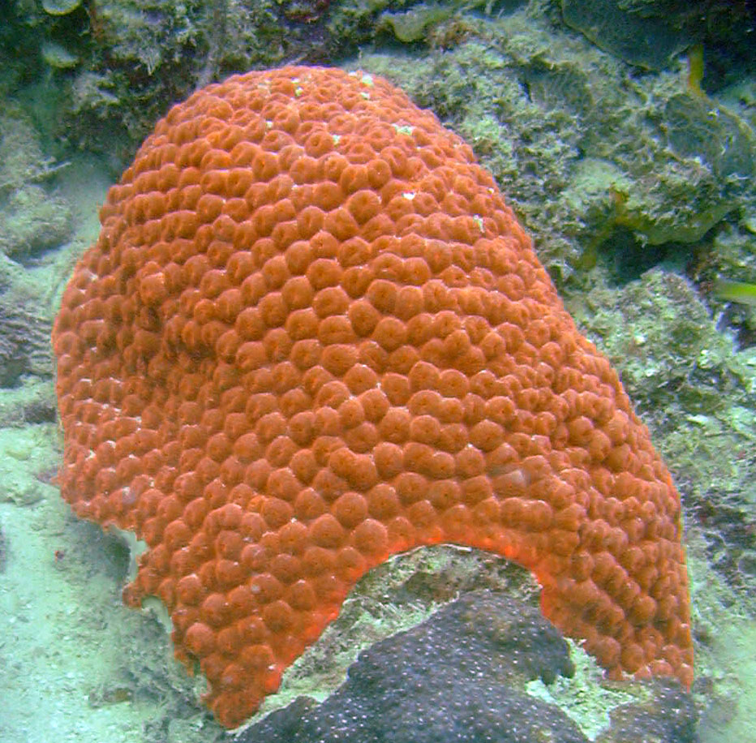
2
3
Four “races” showing strong genetic divergence
Two sympatric “Deep” races highly specialized for deep habitat
“Nearshore” and “Offshore” races are also somewhat specialized (~3x mortality cost if a juvenile lands in a wrong habitat)
Between-race 1st generation hybrids are common
→ Considerable fraction of the genome must be under selection against introgression across race boundaries
M. cavernosa

Slide 15
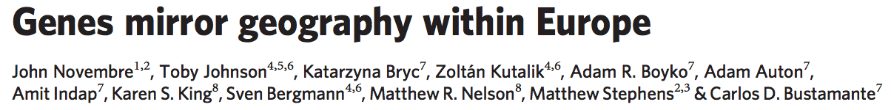
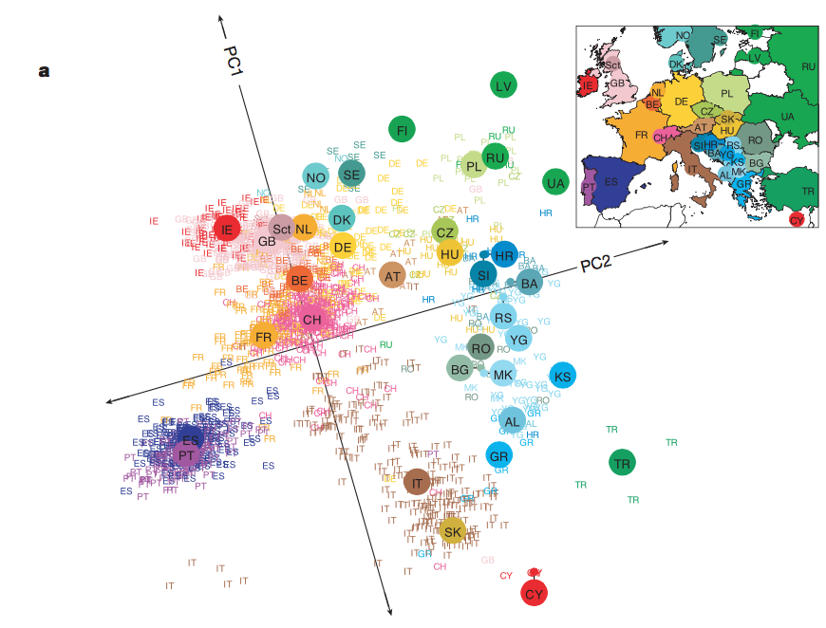

Slide 16
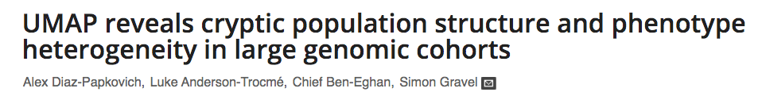
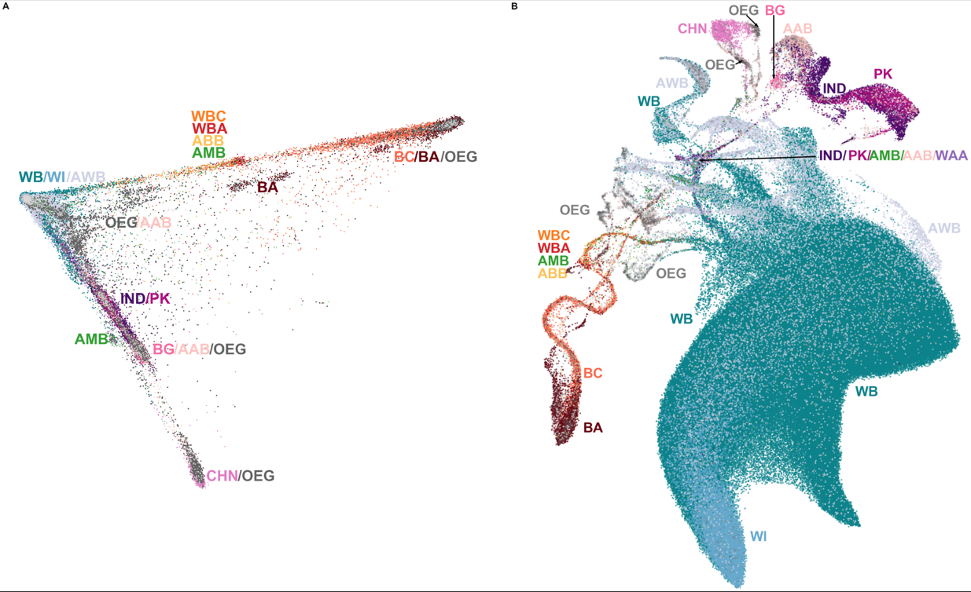
UK biobank: PCA
Colored by self-reported ancestry

Slide 17
Prioritize local structure, do not preserve long-distance similarities
UK biobank: PCA
UMAP

Slide 18
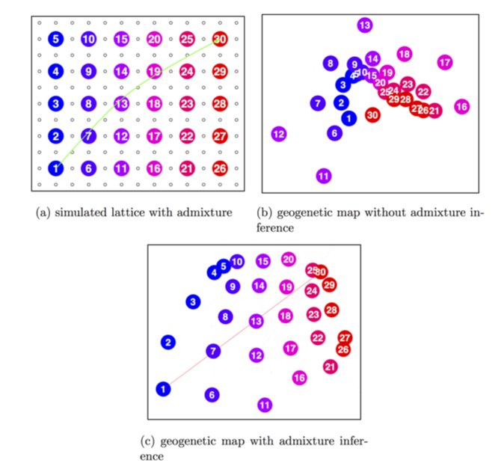
SpaceMix: detects of one-time long-distance migration events

Slide 19
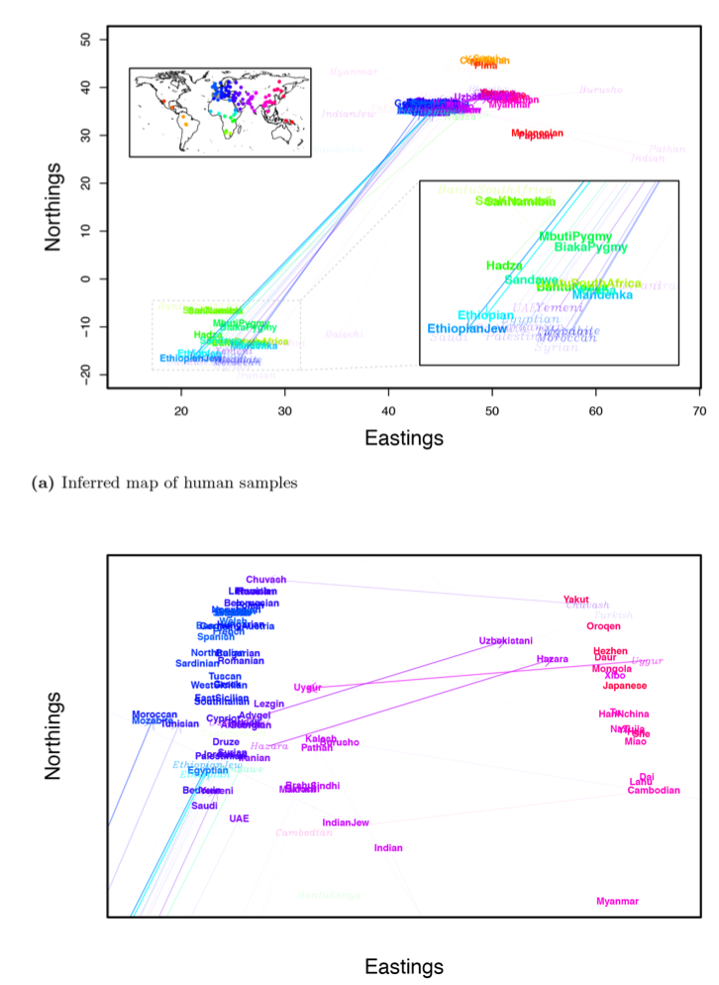
SpaceMix can get rather confusing with real data (“geogenetic space”)

Slide 20
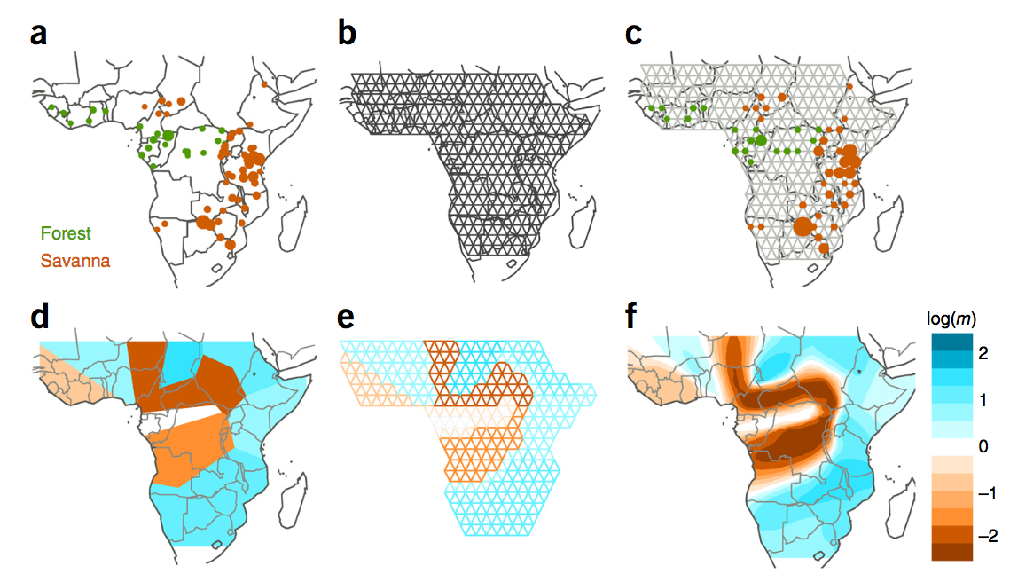
EEMS: quantifies barriers to migration between neighboring points in space

Slide 21
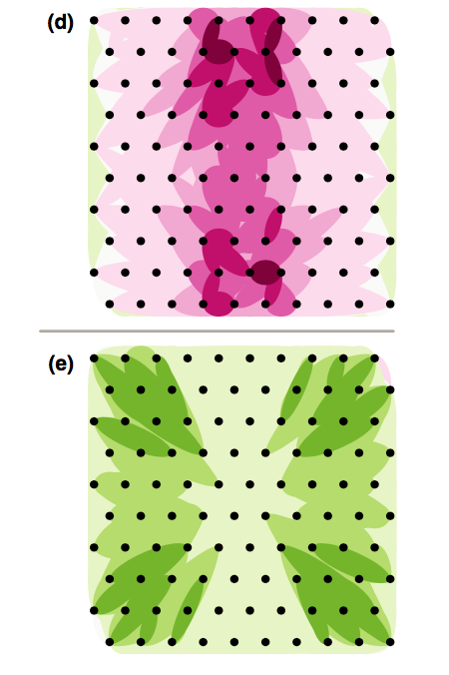
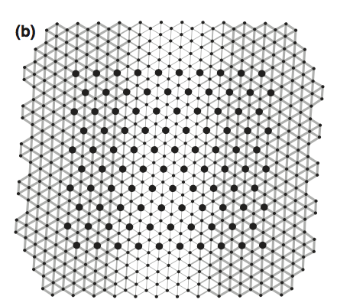
Un-PC: nice simple idea
Lower migration
Higher migration

Slide 22
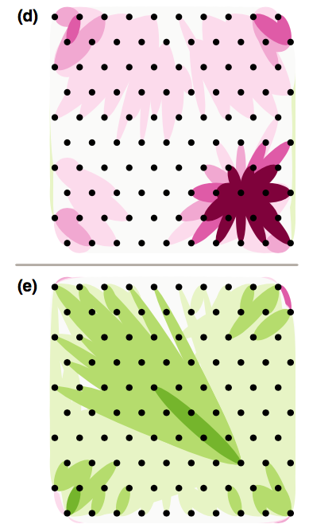
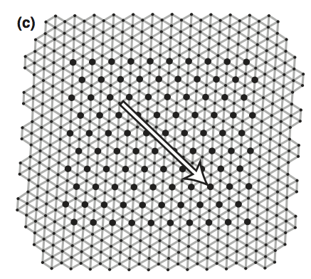
Un-PC: nice simple idea
(does not subscribe to the notion that migration should mostly happen between neighboring populations)
Lower migration
Higher migration

Slide 23
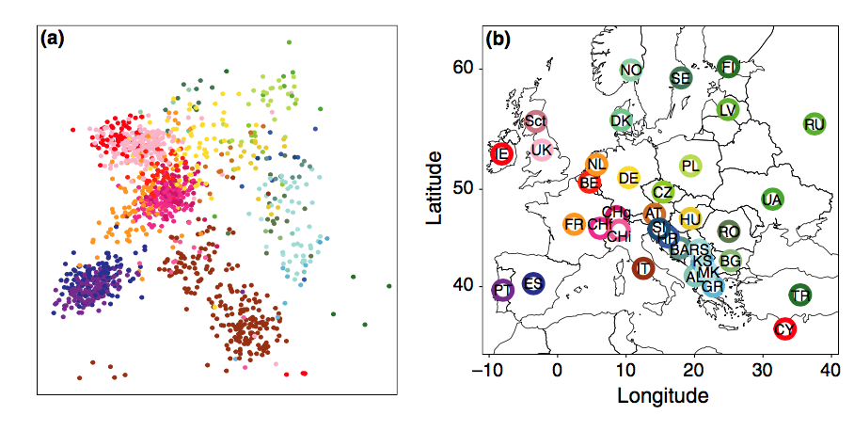
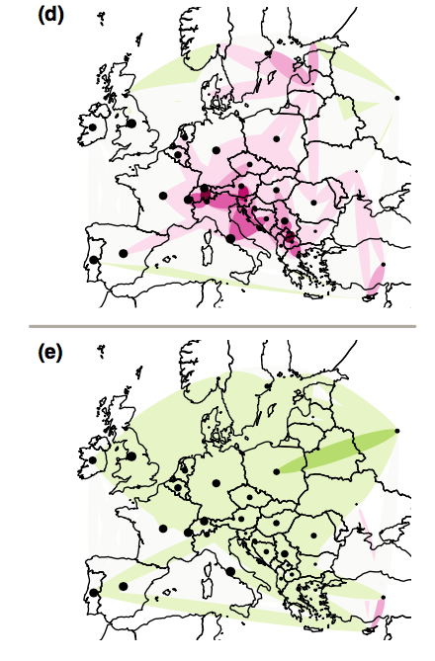
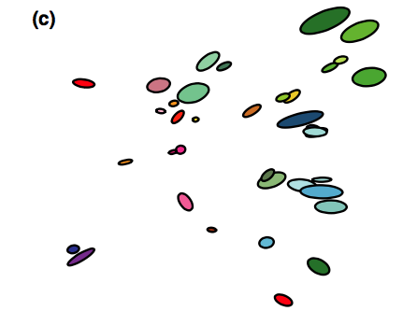
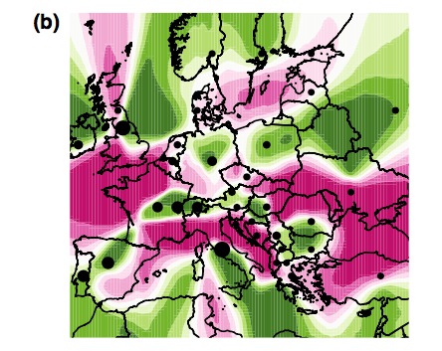
Un-PC
Lower migration
Higher migration
spacemix
EEMS

Slide 24
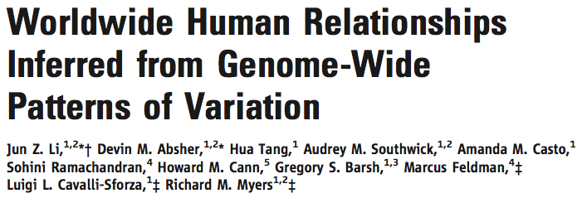
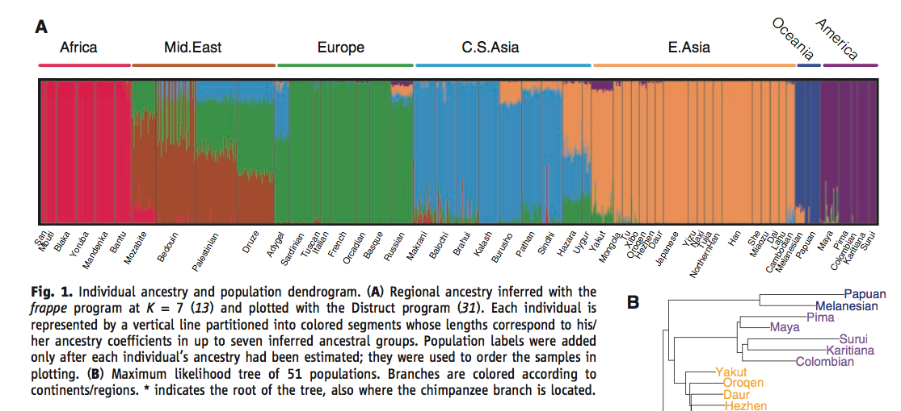
STRUCTURE / ADMIXTURE
Model-based:
assumes K ancestral populations with AFs in HWE
represents each individual’s genotype as a mix of these ancestral populations
must thin data to avoid LD and remove highly differentiated outliers

Slide 25
Idotea baltica
admixturePlotting_v5.R

Slide 26
tess3r

